Slide 1
Chatbot Project
SDEV 265
Steve Carver
Green Team:
Gislaine Azevedo
Zachary Thomas
Kirnechla Davis
Kipp Shinabarger

Slide 2
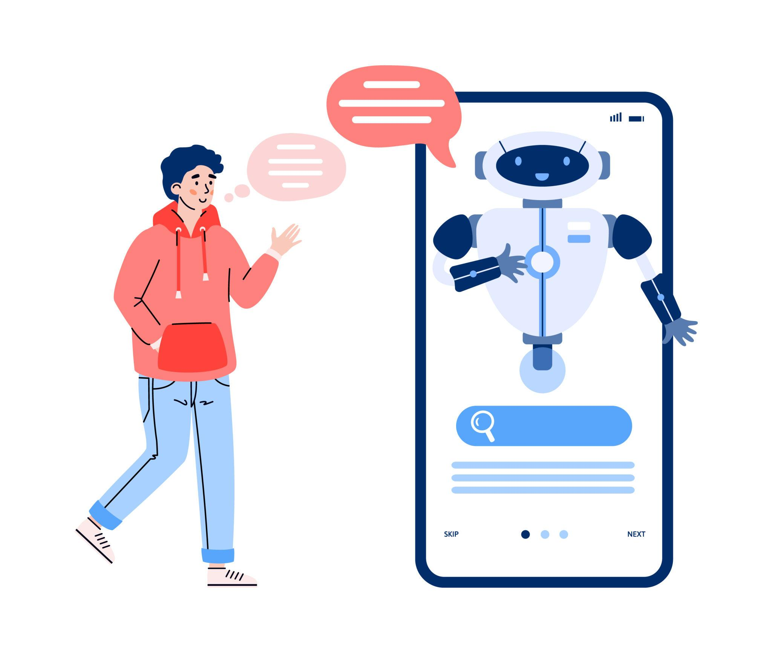
What Is a Chatbot?
A chatbot is a computer program that:
Talks to users through text
Answers questions automatically
Helps people find information quickly
Example:
You type: “Where is the campus?” Chatbot replies instantly.

Slide 3
Why This Project?
Students often:
Don’t know where to find information
Spend time searching the website
Ask the same questions repeatedly
Our solution: A chatbot that answers questions instantly
Works 24/7

Slide 4
Project Goal
Improve an existing chatbot
Make it easier to use
Provide better answers
Help students faster

Slide 5
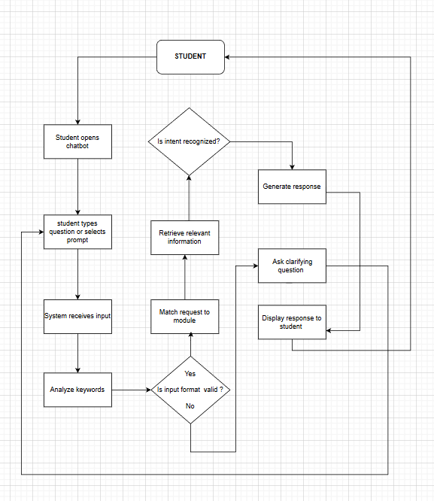
How It Works
User types a question
Chatbot analyzes it
Finds the meaning (intent)
Sends a response

Slide 6
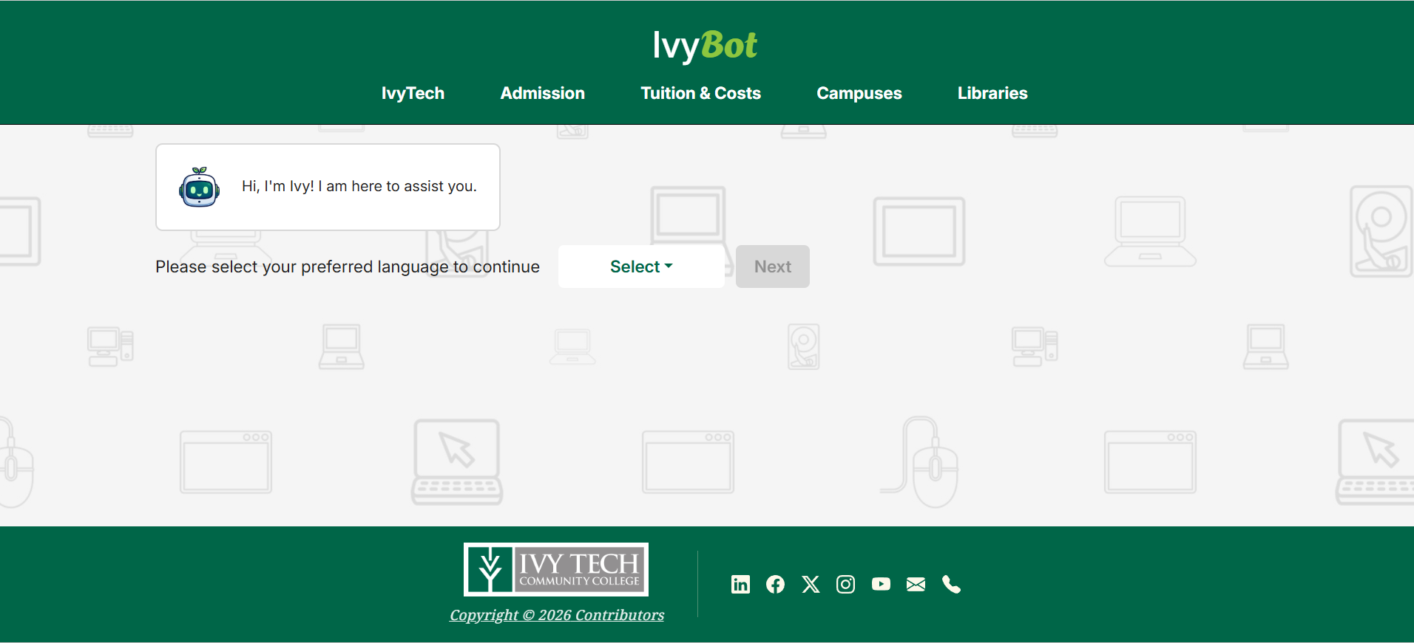
Example
https://ivybot.onrender.com/

Slide 7
System Design
Interface
Logic
Database

Slide 8
Team Roles
Position | Member | Description
Organizer | G. Ferraz Azevedo | Oversees timeline, coordinate tasks, ensures milestones are met
Designer | K. Davis | Designs user interface and chatbot interaction flow
Programmer | K. Shinabarger | Implements Chatbot logic by writing the code using JavaScript
Tester | Z. Thomas | Conducts validation tests and debugging.

Slide 9
Tools Used
GitHub
VS Code
JavaScript
HTML / CSS
Node.js

Slide 10
Implementation
Approach Used: Phased Implementation
Improved the chatbot step by step
Reduced risk of breaking the system
Allowed continuous updates and testing
Why this approach?
The chatbot already existed
Safer than replacing everything at once
Easier to fix issues gradually

Slide 11

Challenges
Learning and understanding existing code
Outdated dependencies
Limited time
Team coordination
Some features incomplete

Slide 12

Key Improvements Implemented
Updated outdated dependencies
Improved user interface and accessibility
Added course catalog search feature
Improved handling of unknown questions
Added help feature and academic resources

Slide 13
What worked well
Improved Chatbot responses
Better User Interface
Added helpful links

Slide 14

Future Improvements
Smarter Chatbot responses
More features
Better Accuracy

Slide 15

Conclusion
Hi, I’m Ivy!
I’ve been improved to better assist students. I will help you find information quickly and easily. And I will continue to improve in the future!

